Slide 1


Lecture 7
Programming Parallel Computers
Lectures: Prof. Janusz Kowalik
Laboratory:
Mgr.Tadeusz Puzniakowski
Informatics Institute
University of Gdansk
October 7-25 , 2013

Slide 2
Part 7
Communicators
Virtual topologies
Example
Summary
3. Performance analysis of parallel codes
An example; computing integral
Accelerating computers
The end of faster processors.
Better (more accurate) models
Key terms

Slide 3
Communicators and Topologies
Definition 1. A communicator is a collection of processes that can communicate with each other.
Definition 2. A topology is a structure imposed on processes in a communicator that allows the processes to be addressed in different ways.

Slide 4
Communicators and ropologies
The communicator MPI_COMM_WORLD permits all processes of the program to communicate with each other at run time.
Occasionally we need to create new communicators from existing ones.

Slide 5
Communications
The are two kinds of communications in MPI
(1) Intra communications ,and
(2) Inter communications.
The first type deals with communications within a group of processes ( within a communicator ).
The second type deals with communications between different communicators.

Slide 6
Communicators
The need for different communicators arises often when we decompose problems, for example we divide large matrices into rows, columns or blocks.
These communicators are often used in conjunction with Cartesian topologies.

Slide 7
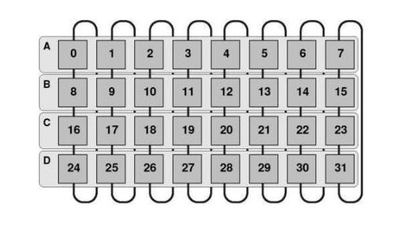
Default rank numbering

Slide 8
continued
The following functions allow to define new communicators.
(1) MPI_Comm-Group
(2)MPI_Comm_Incl
(3)MPI_Comm_Excl
(4)MPI_Comm_Create

Slide 9
Communicators
1.Determines a group of a communicator
2. Builds a group by including processes to a new group
3.Builds a group by excluding processes from existing group
4.Creates a communicator from processes of existing communicator.

Slide 10
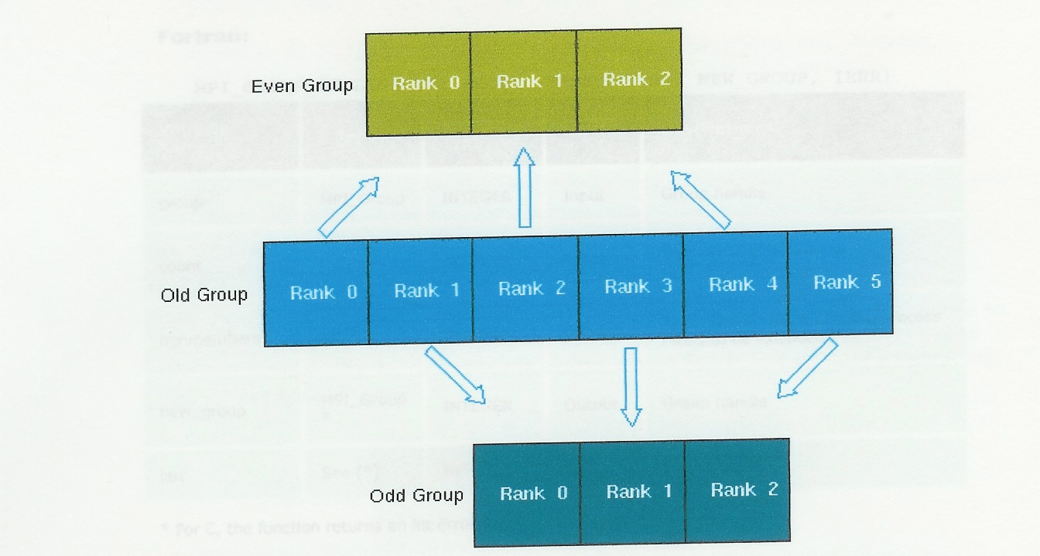
An example
Graphical representation of MPI_Comm_Incl
0
2
4
1
3
5

Slide 11
Virtual Topologies
Many computational problems in science and engineering reduce at the end to manipulating matrices or grids. MPI provides several functions for creating virtual topologies. One of them is:
MPI_Cart_Create;
This function creates a new communicator using Cartesian Topology.
The syntax is:
MPI_Cart_Create (old_comm, ndims, dim_size, periods, reorder, &new_comm);

Slide 12
Example MPI_Cart_Create
#include mpi.h;
MPI_Comm (old_comm,new_comm);
int ndims, reorder, periods[2], dim-size[2];
Old_comm=MPI_COMM_WORLD;
ndims=2;
dim_size[0] = 3; /*rows*/
dim_size[1] = 2; /*columns*/
periods[0] = 1; /*each column forms a ring*/
periods[1] = 0 ; */ column non-periodic*/
reorder=1;

Slide 13
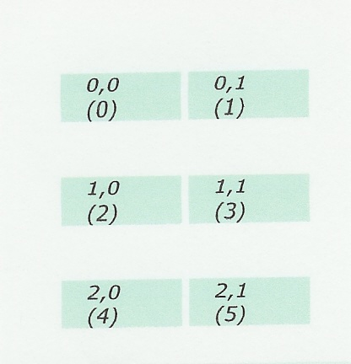
Cartesian Grid
Graphical representation of the virtual topology: Cartesian Grid.
Old rank numbers
are in parentheses.
Now we can refer to
processes using
double Indices.
Useful for handling
two dimensional grids

Slide 14
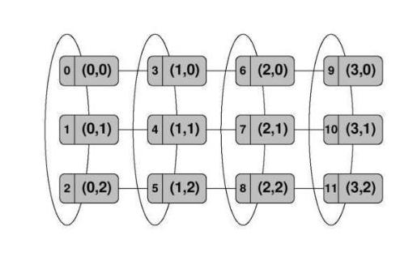
Cartesian rank topology
3x4 grid of processes with the serial rank and a Cartesian 2D ranking.

Slide 15
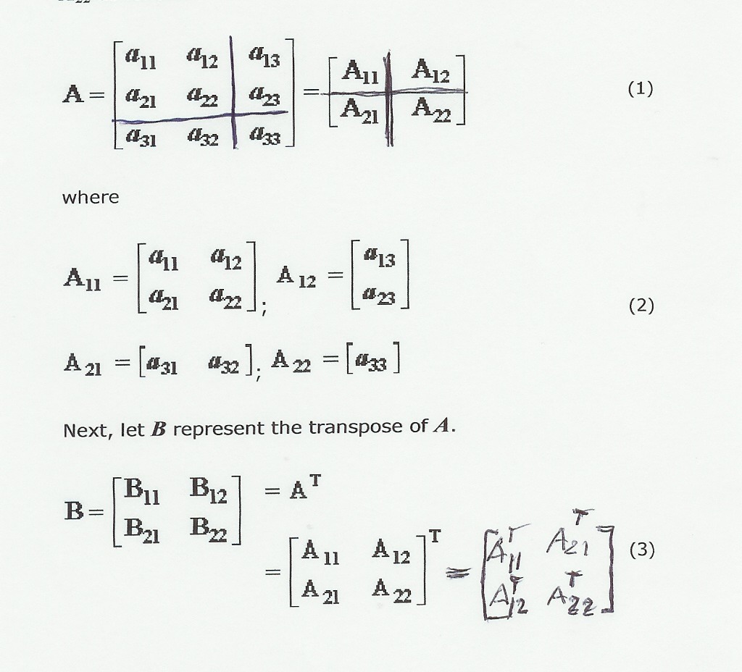
Example: Transposing matrix

Slide 16
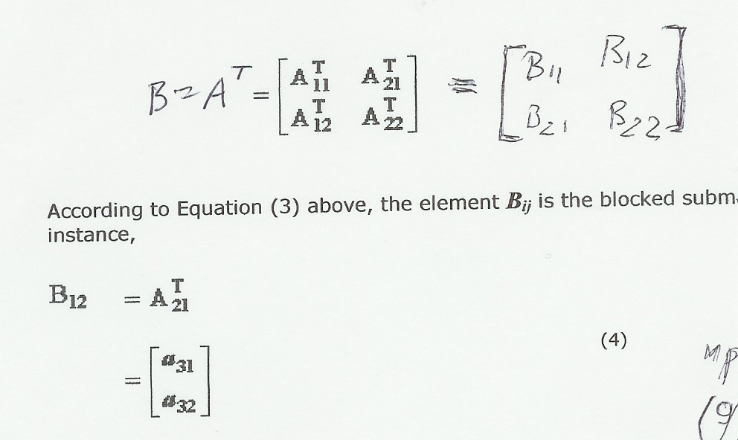
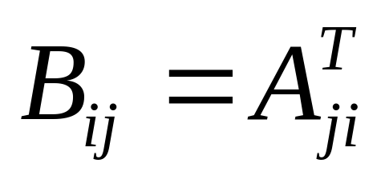
Transposing matrix

Slide 17
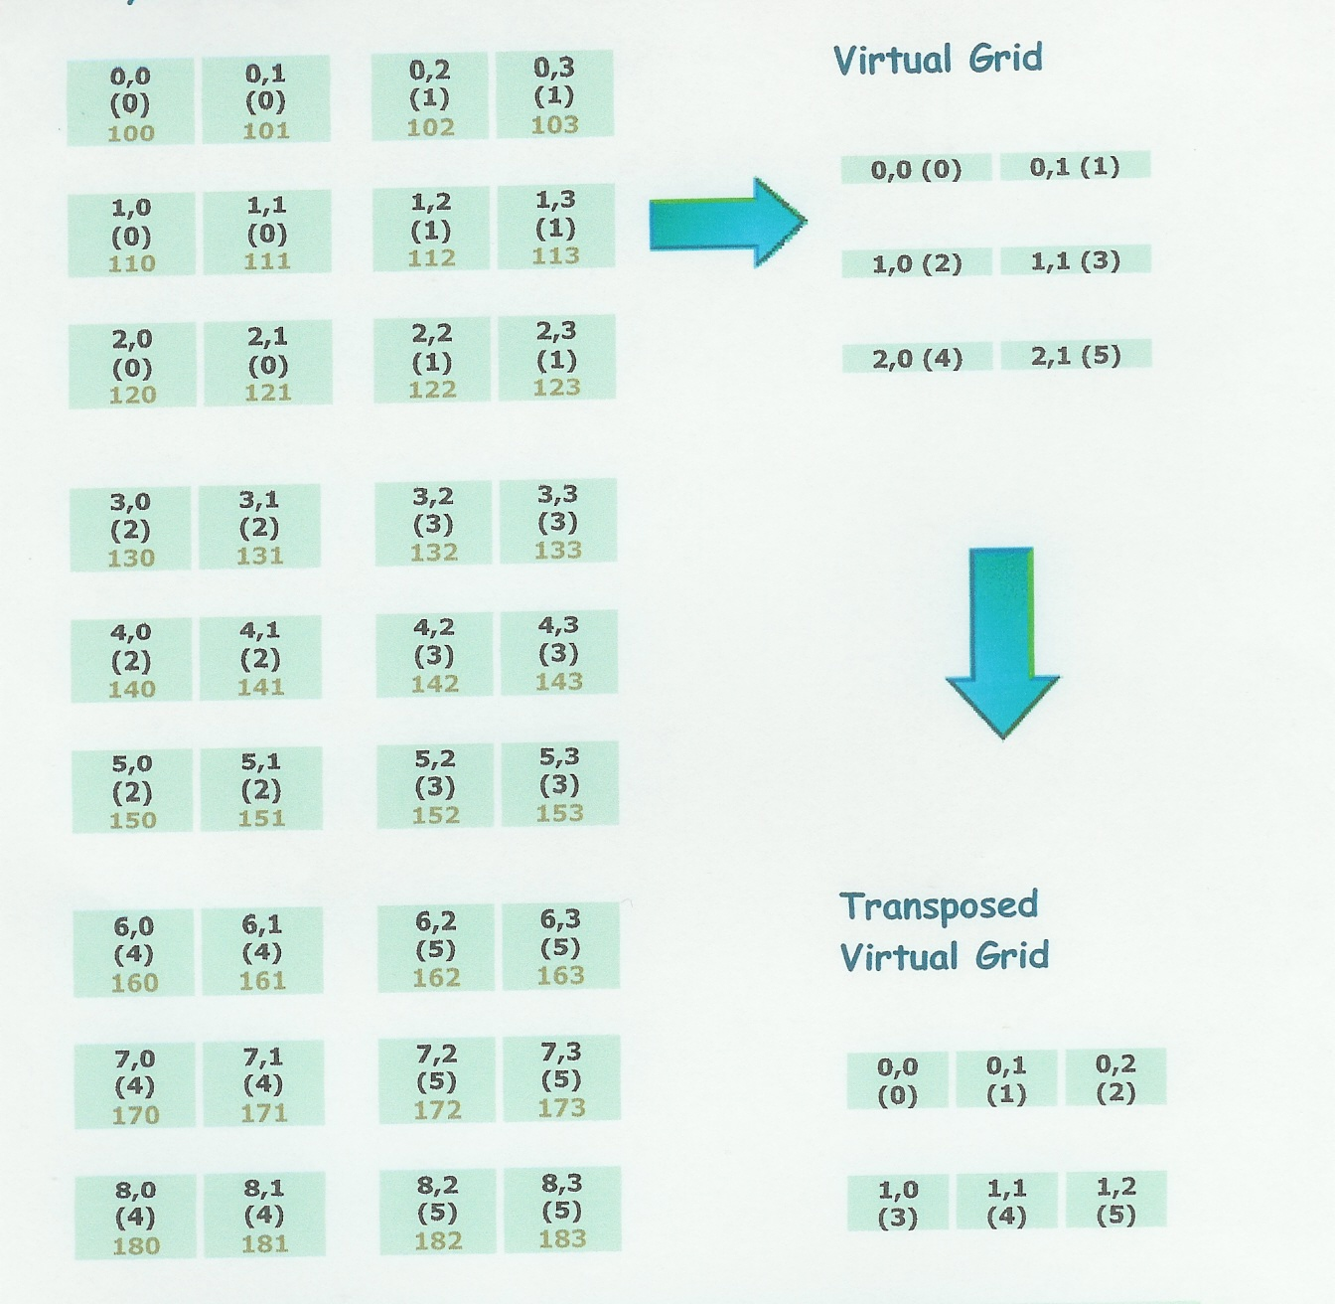
An Example.
n=9
m=4
p=3
q=2
nprocs=6

Slide 18
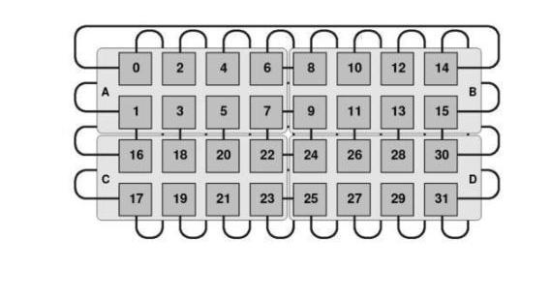
Perfect ranking
This is the perfect ranking .Each process is connected to 12 other processes.

Slide 19
Summary
1.Using MPI programmer has all data
partitioning and movement decisions in
his/her hands.
2. To minimize communication data must
be grouped as much as possible.
3. But the overhead of grouping has to be
kept in mind.
4. Creating suitable communicators may help in programming effort making programs more readable and less prone to errors.

Slide 20
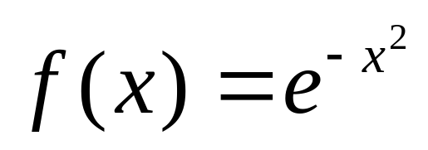
Performance of parallel codes
The source: Parallel Programming with MPI, by Peter S. Pacheco, Morgan Kaufmann 1997.
Performance analysis of the Trapezoidal Rule integration program discussed in Part 5.
The integrated function:
a=-2 , b=2
In general,the code execution time
depends on three factors:
1. The hardware being used
2. The programming language and compiler
3. Algorithmic requirements

Slide 21
Sequential code analysis
The considered algorithm
h=(b-a)/n;
integral=( f(a)+f(b))/2.0 ;
for (i=1; i<=n-1;i++) {
x+= h;
integral+=f(x);
}
integral=integral*h;
Where is the
major work done??

Slide 22
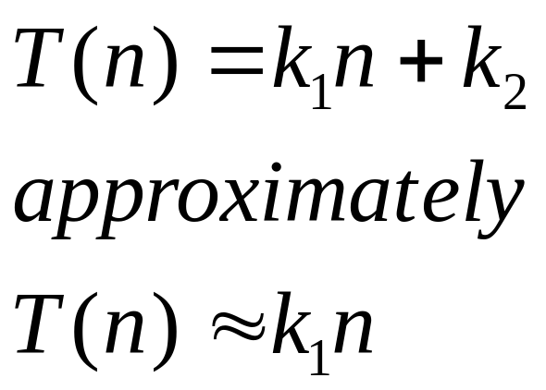
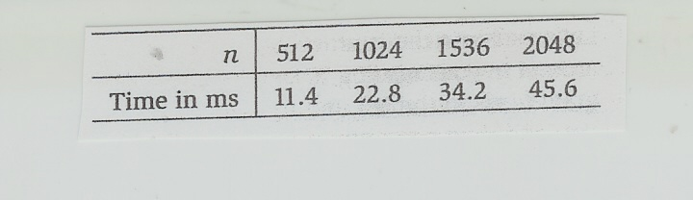
continued
We can assume that :
The experimental data

Slide 23
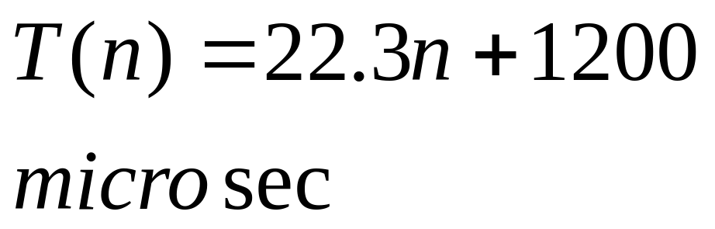
Calibration
I/O time
For many applications we must take into account the I/O time.
In our case this time is only a constant correction.
We add a constant to account for input and output.
The run times with I/O
n 512 1024 2048
msec 12.6 24.0 46.8
This gives:

Slide 24
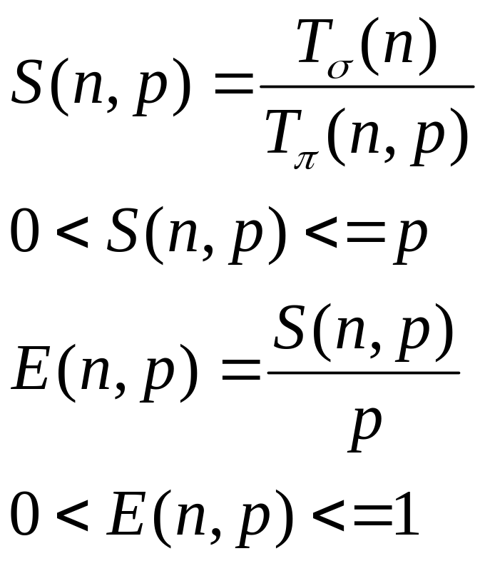
Parallel code analysis
The common measures of parallel performance are the speedup and the efficiency.:
If the program efficiency is
1 the program exhibits
the most desirable linear
speedup.
Superlinear speedeup.
If E(n,p)<1/p
The program exhibits
slowdown.

Slide 25
Parallel performance analysis
The cost of communication.
We need to analyze the cost of communication.
The full expression of the parallel execution time:
The scalability analysis determines how these
three components change when we increase
the problem size n and the parallel computer size p.

Slide 26
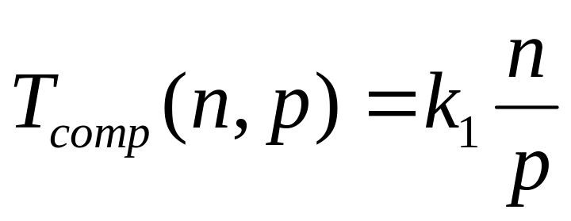
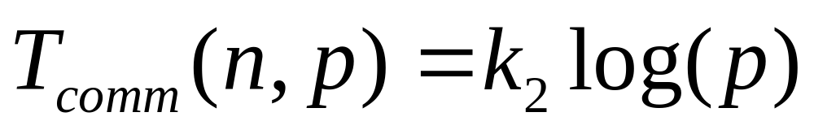
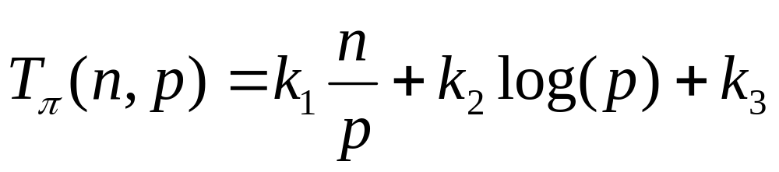
Parallel performance analysis
The computational time will be reduced:p times
WHY???
The total parallel time is:

Slide 27
Total time
Computation plus communication
Comp time inversly proportional to p and proportional to n
I/O time constant ;printing results.
Reduction time is logarithmic

Slide 28
Question ,
Why we can assume that the communication time for the Trapezoidal integration program has the form:???
The reduction time!!
A constant

Slide 29
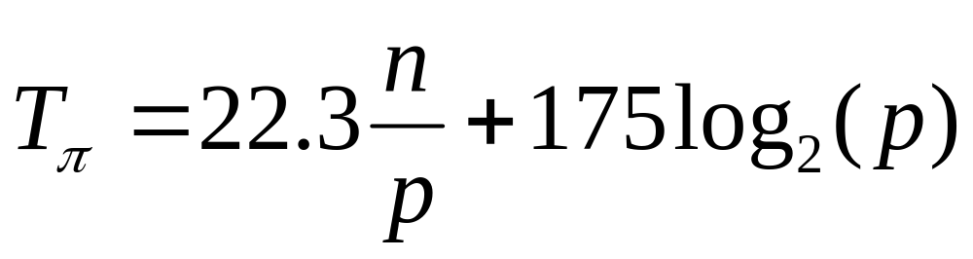
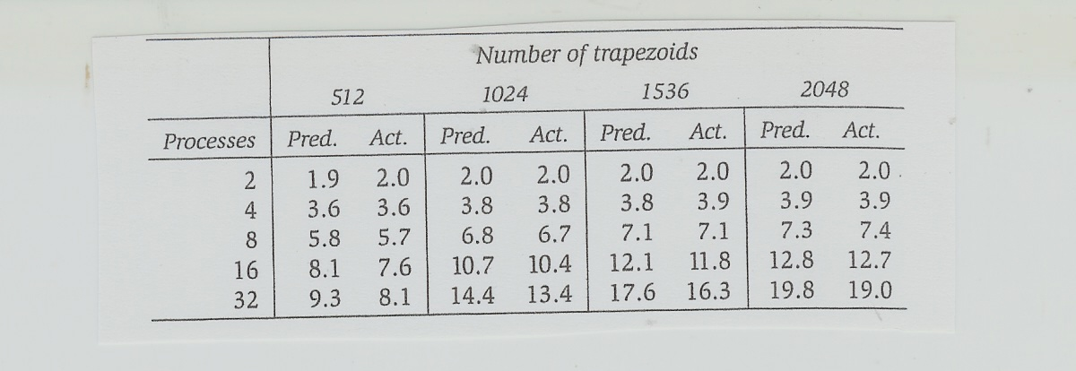
Parallel performance analysis
The specific formula is:
Experimental results :

Slide 30
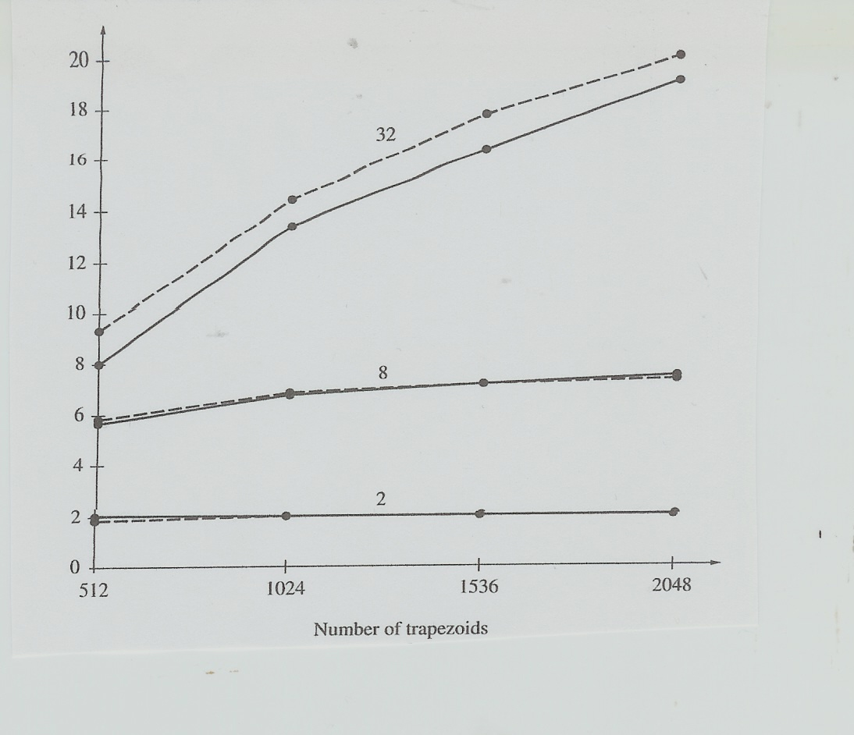
Parallel performance analysis
Modeled versus experimental results

Slide 31
Summary discussion
The following steps are performed in the performance of parallel programs:
1. Develop a formula for the serial runtime
2. Estimate the constants in this formula
3. Develop the formula for the parallel runtime
4. Estimate the values of the constants
5. Estimate the speedup
6. Calibrate the runtime formulas timing several runs.

Slide 32
Accelerating computers I
A) Improving Hardware
Processor clock cycle reduction,caches
B) Computer architecture improvements
Cache based microprocessors
Pipelining instructions and operations
Vectorization
VPUs Vector Processing Units
C) Better program execution
Compiler improvements
: Out-of-order execution,prefetching

Slide 33
Accelerating computers II
D) Parallelism
Pipelining arithmetic units, Multi-core CPUs
Massively parallel accelerators
NVIDIA,AMD ,Intel XEON PHI Co-processor.
E) Better algorithms
For example FFT, Sparse matrix techniques,
Quicksort.

Slide 34
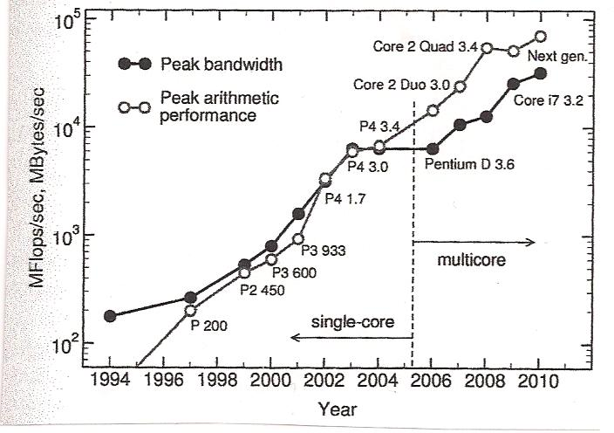
Max speeds of computation and bandwidth
Peak Computing speed
Versus peak memory
Bandwidth speed for
Intel processors.
Data collected by
Jan Treibig and quoted by
G.Hager and G.Welein
in reference number [9].

Slide 35
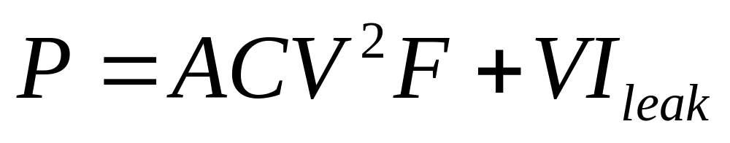
Clock cycle reduction
CPU circuit power equation [3]
A-the activity factor, transistor switching fraction
C- the circuit capacitance
V- the voltage applierd across the circuit
F- the switching frequency
I (leak)- the current due to the leakage of transistors.The frequency increase requires increasing voltage

Slide 36
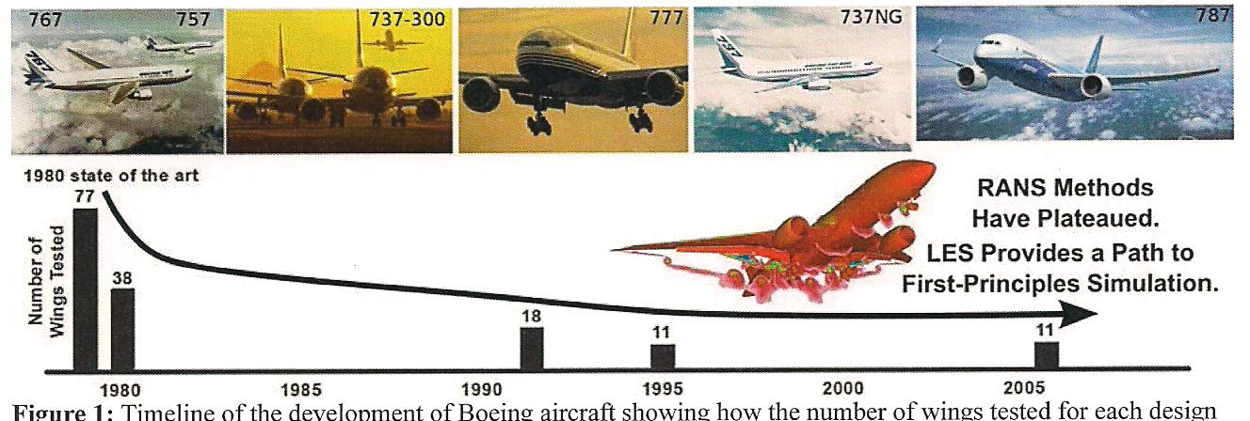
A Boeing example
Digital Simulation has replaced
wing tests in wind tunnels.
Data from 1980 to 2005.
A conversation with the Chief Airplane Designer

Slide 37
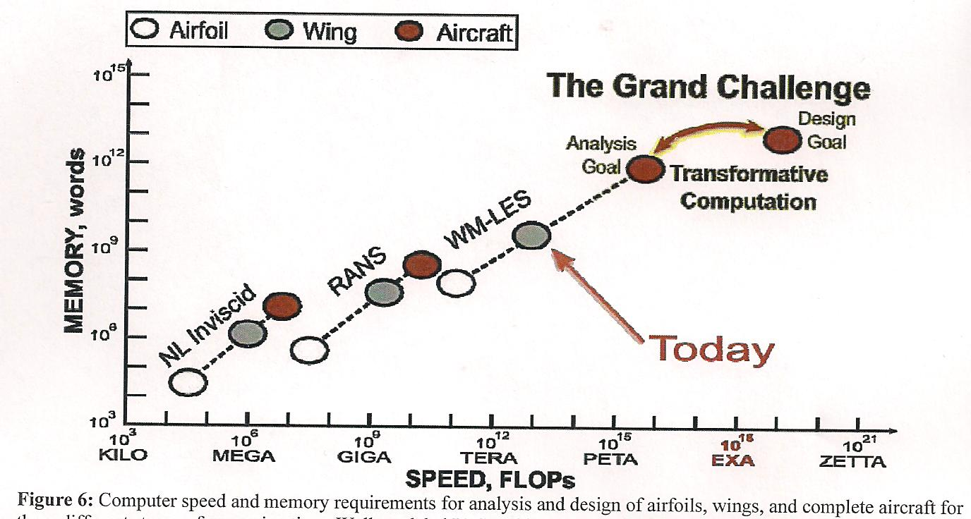
Aircraft design progress
An example of the scalability race

Slide 38
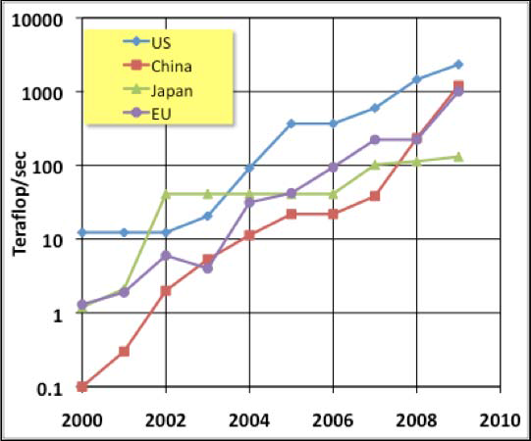

The world competition

Slide 39
Key Terms
AllGather
Blocking and nonblocking
Broadcast
Buffering messages
Cartesian topology
Collective communication
Communicator
Contiguous memory locations
Derived data types
Vector structure
Parallel matrix transpose
Local communication
Global communication
Intercommunication
intracommunication
Virtual topology

Slide 40
English terminology
Timing- time estimation
Performance analysis
Theoretical analysis
Experimental confirmation
Logarithmic communication time
Linear computational time
Computational time complexity
Total time complexity

